Slide 1
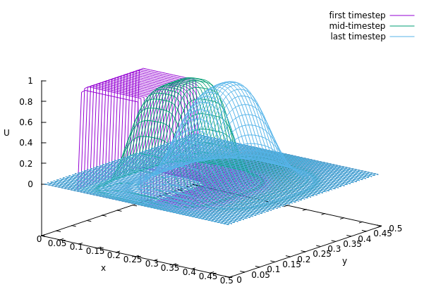

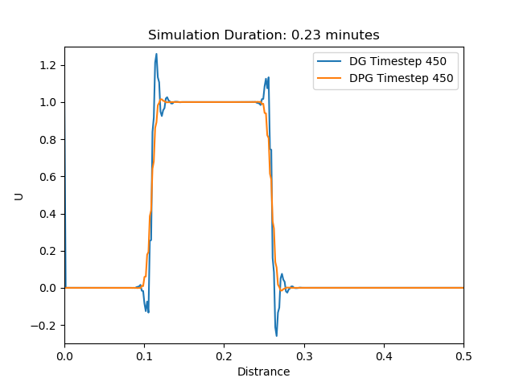
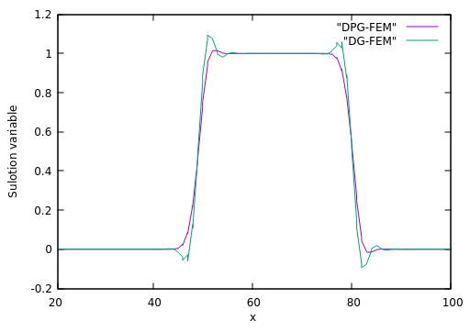
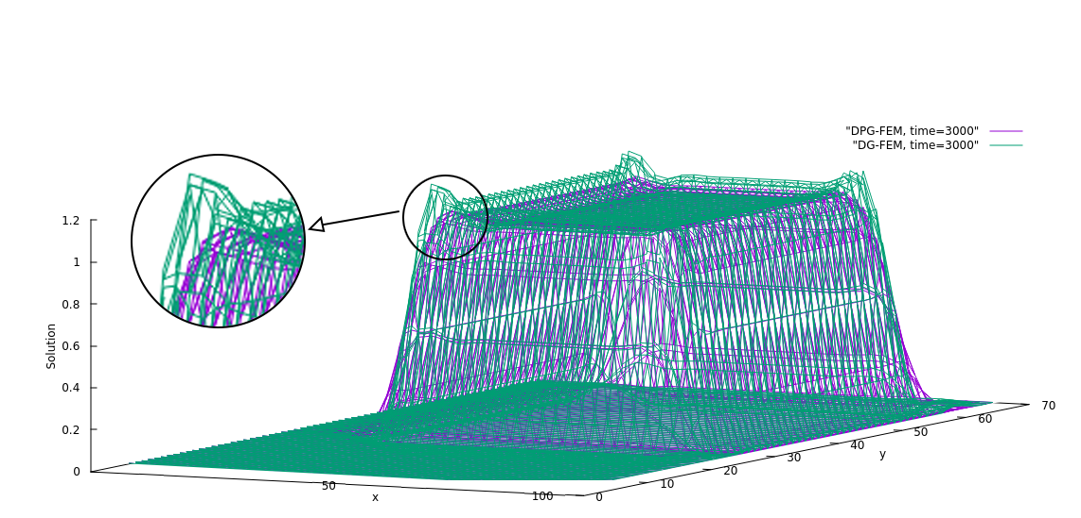
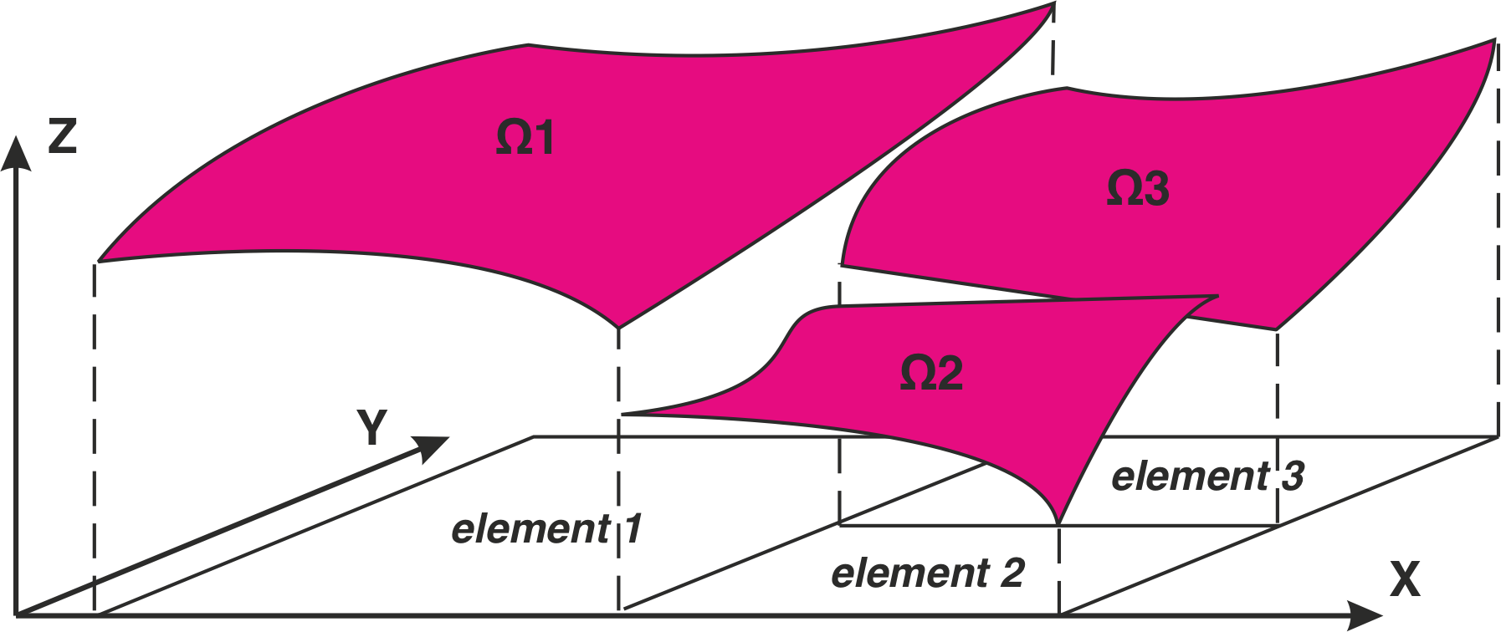
UNDERPINNING SCIENCES
Dynamic semi-structured meshes for fast numerical simulation of multi-phase modelling in energy industry
PI(s): Prof Christopher Pain
Co-I(s): Dr Pablo Salinas
bp Mentor(s): Dr Andre Nicolle
Researcher(s): Amin Nadimy
Introduction & Project Aims
Multiphase-Fluidity incorporates state-of-the-art technology for multiphase Navier-Stokes flow simulation, including unstructured dynamic mesh optimisation, high order element methods. Applications of Multiph. Currently, Multiphase-Fluidity uses fully unstructured meshes. Flexible meshing technology is required in order to honour the complex geometries that naturally occur in engineering | applications. However, numerical simulations using unstructured meshes are inherently slower than those using structured meshes due to the indirect addressing required by the former. This is partly compensated in Multiphase-Fluidity by using dynamic adaptive mesh optimisation which reduces the number of elements whilst maintaining required resolution to correctly model the physics. | The aim of this project is to develop and implement a semi-structured mesh approach within Multi-Phase Fluidity project to significantly improve its speed. The method will be assessed based on jet flow, which required high-dynamic precision.
Results
The results for 2d-P0 simulation in Fortran shows the gradual decay of the wave which matches with the theory, see Fig 3.
Fig 3. 2D DGFEM for P0 elements
The Petrov-Galerkin stabilisation resulted in less oscillations at the jumps, in the standard DGFEM, see Fig 4.
Introduction
Methodology
The finite element method (DG-FEM) is a widely used method for solving problems of engineering and mathematical models, especially in fluid dynamics involving partial differential equations, which works based on the conservation laws. This method subdivides the domain into smaller sections called elements, see Fig 1. Algebraic system of equations is the results of FEM discretisation which has a finite number of points.
This method approximates the solutions over the domain at the elemental scale. Then, the global system representing the whole problem is constructed.
Discontinuous Galerkin FEM method integrate features of the Finite Element for solving variables inside the elements and also the Finite Volume method for dealing with boundaries and communications among elements. Therefore, it has the advantages of both the finite volume and the finite element methods, in that it can be effectively used in convection-dominant applications, while maintaining geometric flexibility and higher local approximations through the use of higher order elements. This method minimises the associated error function using the variational methods introduced by variations of the solution approximations.
Fig 1. Illustration of a DG domain
In this part of the project the transport equation, Equation 1, has been studied by DG-FEM in 1 and 2 dimensions explicitly, meaning that no solver was needed.
Eq 1
For the training purpose the initial code for P0 in 1D was written in Python. Then a stabilisation method called Petrov-Galerkin method was applied to reduce the oscillations.
Fig 2. Standard vs stabilised P0-DGFEM
In the next step, the code was transferred into Fortran and extended to 2D. Initially, P0 was coded, meaning that the solution variables located at the center of each element. This model is identical with the Finite Difference method and easy to develop.
Then, P1 code was developed, meaning the solutions were estimated within each element linearly that gives higher resolution and more precision in estimating the results. Finally, the code was debugged and optimised to solve the problem much faster and expanded to be more general to be able to simulate higher order problems.
Fig 4. P1-DPG vs P1-DG with the same ICs in 1D
The success of simulating the wave equation in 2D with the standard DG and DPG methods is depicted in Fig 5. The next step will be to increase the order of stabilisation for further smoothness of the results.
Fig 5. P1-DPG vs P1-DG with the same ICs in 2D
Ultimate goals
The first ultimate goal of the project is to develop a code which is able to solve partial differential equations very fast.
The second ultimate goal of the project is to implement semi-structured meshes to the code which can further increase the speed the simulations.
The third ultimate code of the project is to develop the general code with semi-structured meshes which are able to simulate the Navier-Stokes’ equation.
ICAM62 Date: 06/2021

